Slide 1
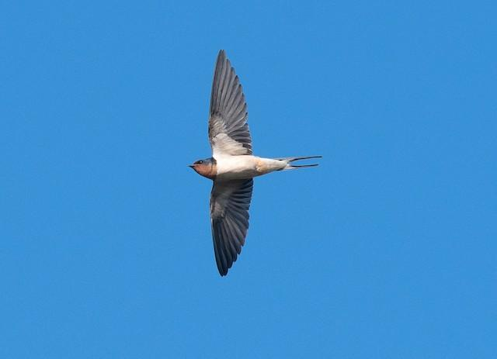
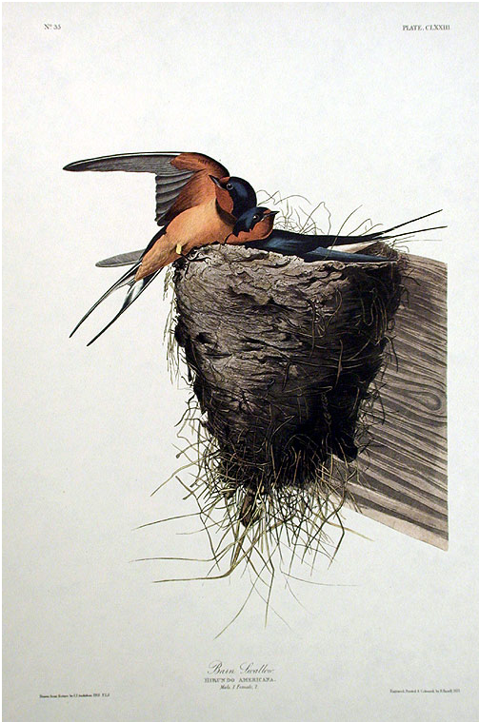



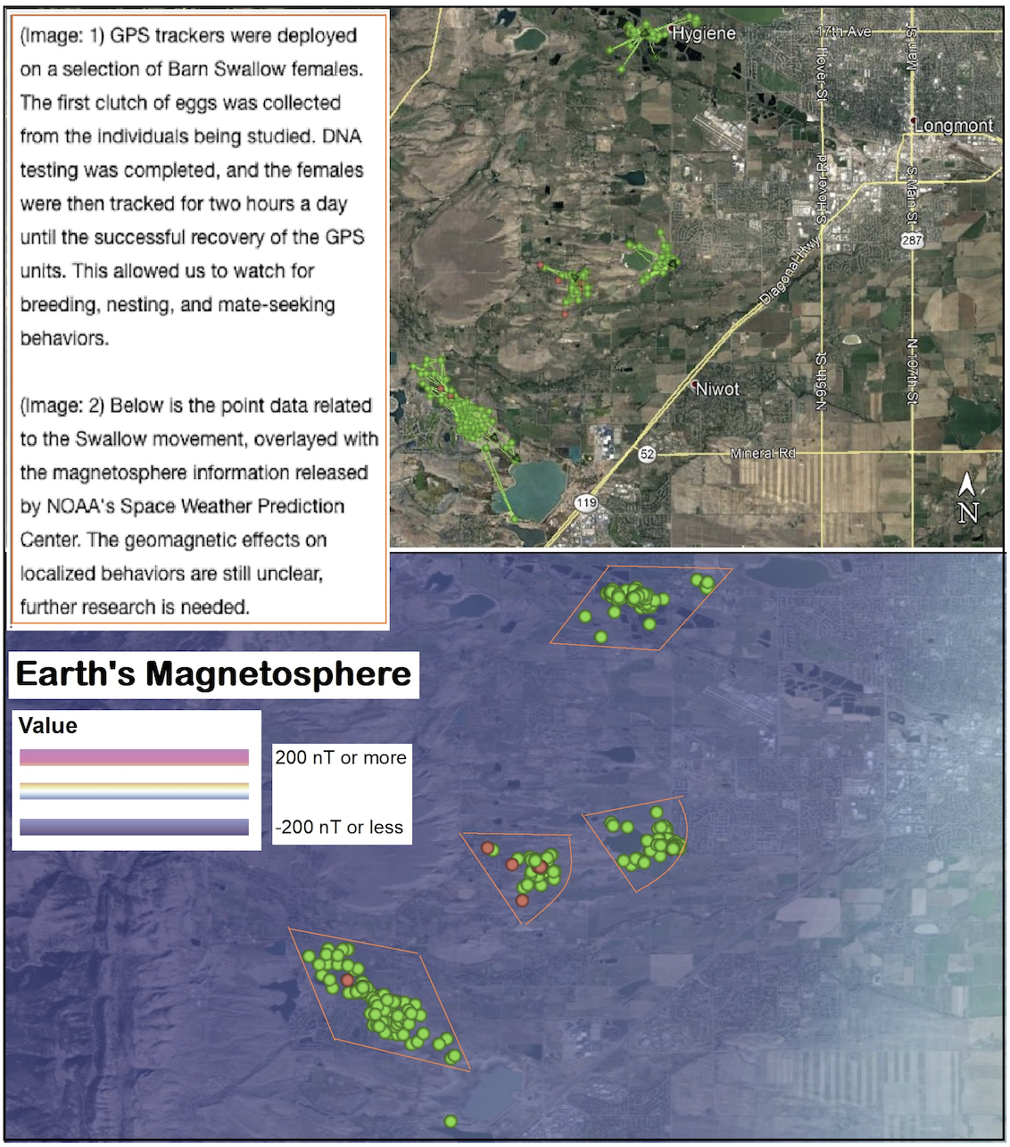
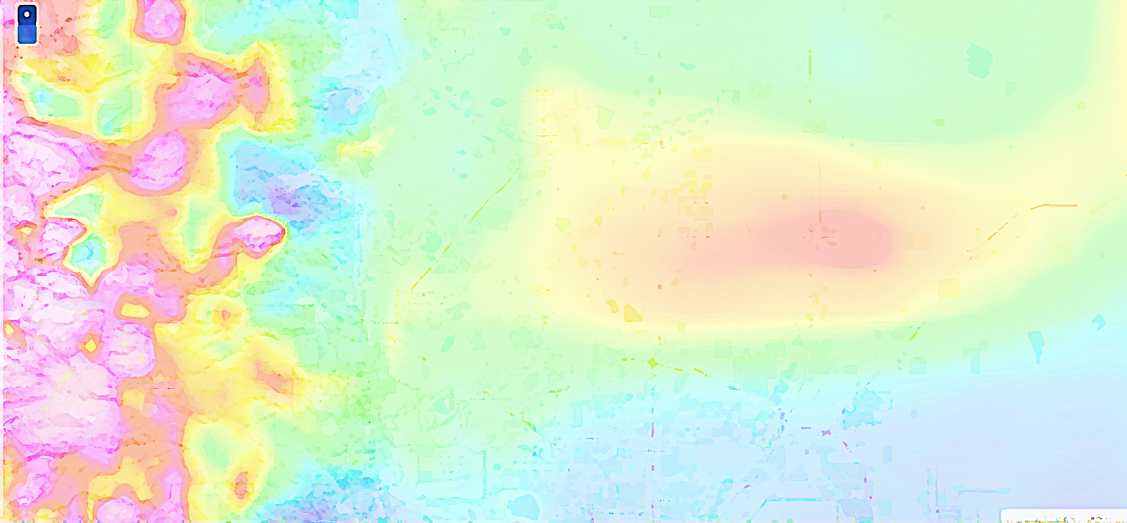
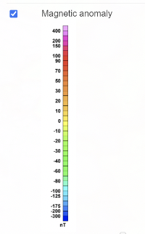
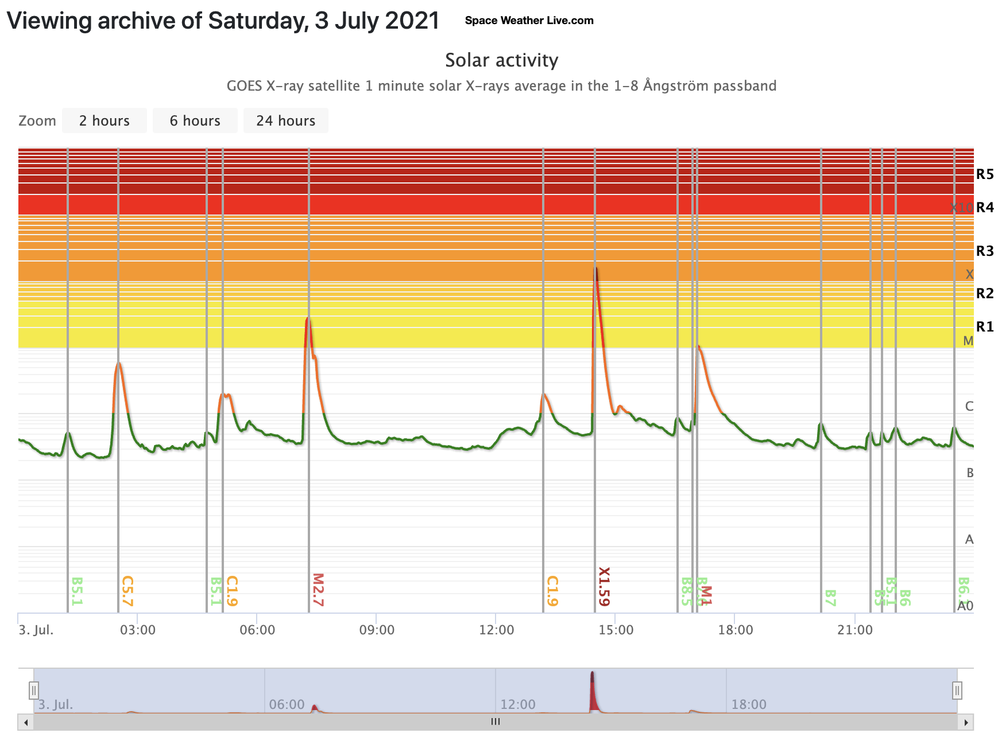
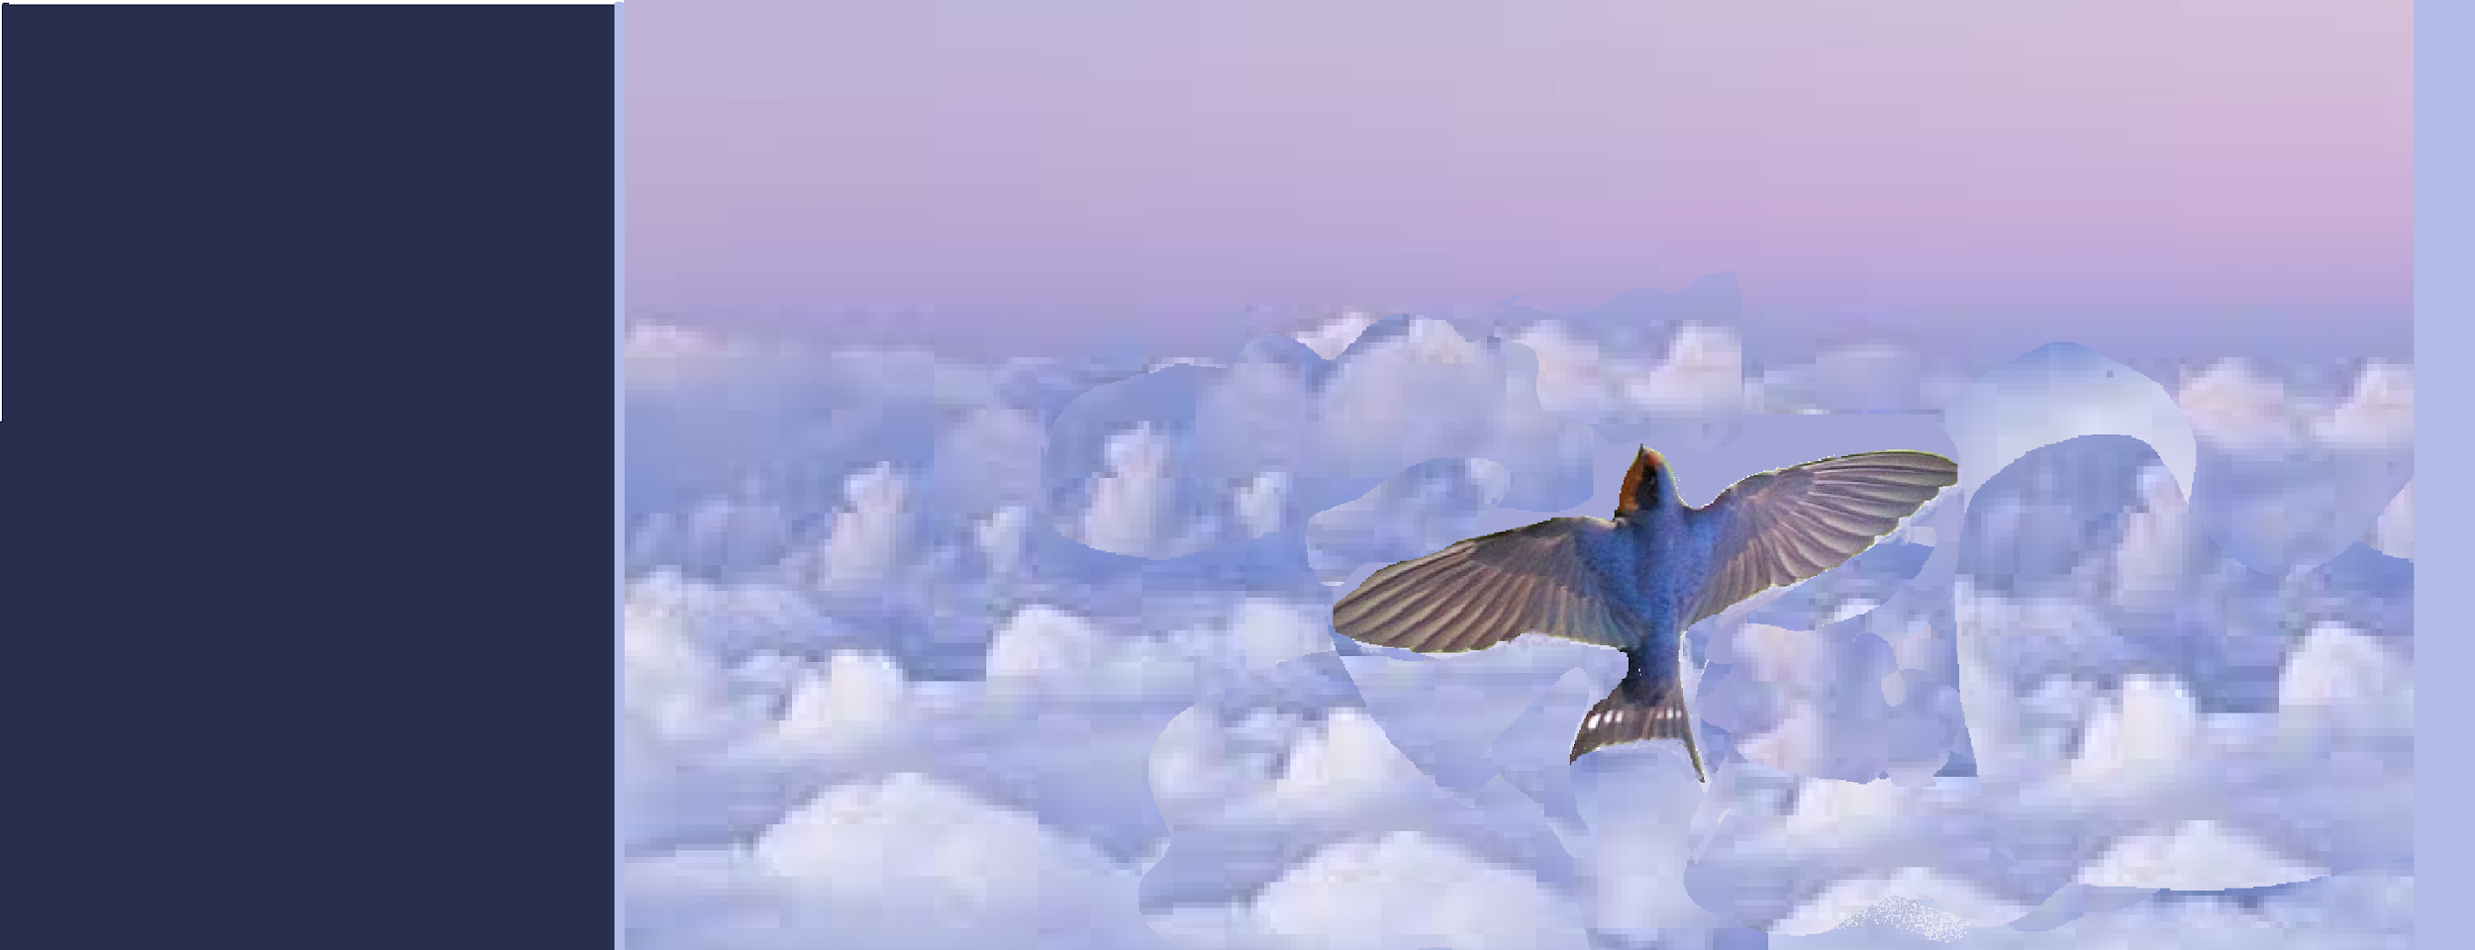
Observational Study of Barn Swallow Microbehaviors in Relation to Geomagnetic Fields
Elizabeth Mathews¹, Heather Kenney², Dr. Rebecca Safran ³, Dr. Rick Saltus⁴,
Avani Fachon⁵
In evolutionary biology we study how species and speciation develop on Earth. One overlooked factor in the evolutionary process is the presence Earth’s magnetosphere, and the recurring Solar disturbances that it has shielded us from. For as long as there has been life on this planet, that life has been protected largely from solar and deep space radiation by Earth’s dynamic, and fascinating geomagnetic and Solar environment (EGMF) coverage. We’ve seen the effects across taxa, and are most familiar with how migratory species use geomagnetic lines to navigate across the globe, but with the growing field of quantum biology and increased satellite and crowdsourcing data, we may soon get a deeper look at the quantum compasses in our planetary biology. In this study, we recorded the localized movement and microbehaviors of the Barn Swallow and compared them to real-time geomagnetic data and solar events.
For more information, contact me at emathew3@msudenver.edu
Abstract
Background
Discussion
Data Set
Results
Migratory animals use earth’s geomagnetic fields to guide them in their navigation. In diurnal migratory birds, like the Barn Swallow, the quantum biological mechanism for this physiological response has been identified as a protein in the retina called Cry-4 Cryptochrome. While migration, the “macrobehavior” movement of many species has been studied with Earth’s magnetic fields, localized movements, or microbehaviors, have been nearly impossible to measure in relation to geomagnetism. The delicate technology needed to safely and accurately track species is improving alongside developments in satellite utility, GPS, and Space Weather Monitoring. If Barn Swallows are sensitive to magnetic fields as suggested by quantum biology, might we see indications of that outside of migration season - such as in nesting, breeding, and foraging behaviors?
Question: How sensitive are quantum compasses in birds and other species? And why now should we still care about the ancient riddle ‘How do some creatures always instinctually know where they are and where they need to go?’
The Cry4 cryptochrome, found in the retinas of many migratory species, creates a quantum compass across species. The radical pair mechanism present int Cry-4 creates a tiny electrical charge that responds to the geomagnetic fields.^{[1]}
NOAA’s project, CrowdMag, is a crowdsourcing ap that uses the built-in components of cell phones to take magnetometer readings.^{[2]} This brings new access to collective, real-time, data about Earth’s dynamic geomag system.
A population of Barn Swallows in Boulder-Longmont, Colorado have been studied by CU Boulder’s Safran lab since 2008.^{[3]}
Geomagnetic data is helping biologists understand how species movement and Earth’s magnetic fields are related.^{[4]}
The question remains, what happens to ”quantum compasses” on smaller scales? Do geomagnetic storms or solar events affect migratory animals while not in migration? Do nesting patterns, egg-laying behaviors, breeding, or foraging habits change as a result of these disturbances? Other species show evidence of having brain waves altered during geomagnetic storms (alpha and theta waves in humans). Looking at the affects EGMF has on human brains and behaviors suggests a cross-species sensitivity of varying degrees, and one that may be spectral for each species. If we are to believe quantum mechanics are responsible for subatomic reactions, we should consider finding ways to test quantum biology in the real world.
Methods
Barn Swallow nesting sites were monitored on alternate days for activity by Dr. Rebecca Safran’s team of CU Boulder students. Eggs, feathers, and nestlings were documented, as were ID observations and leg-banding to identify individual swallows in the future.
At each site, magnetometer readings were collected using the CrowdMag ap. This was then compared to the NOAA collection of magnetometer to reduce uncertainty.
Declination (the angular difference from True North) and Total Field intensity were recorded, along with lat/long/altitude, and the number of breeding pairs at each site (a measure of activity and parenting).
A GPS tracking device was attached to 17 random female Swallows, and their movements were mapped between 7 am and 9 am until the GPS units were retrieved.
Images were compiled through ArcGIS, QGIS, NASA’s Solar Observatory and National Weather Service (NWS), GONG, and the European Space Agency (ESA) Swarm Mission
Behavioral anomalies were recorded and then compared to the days during which significant magnetosphere events occurred. This included abandoned nests, odd egg-laying patterns, desynchronized hatch days, and decreased parental care during the 1-3 day time frame of each event.
https://mrdata.usgs.gov/magnetic/map-us.html#home
Magnetic Anomalies in Boulder-Longmont Region
Conclusions
Image displaying the recorded Solar activity in activity on July 3, 2021. Class X-1.5, largest in 4 years (NOAA SWPC)
The nest sites we monitored showed a consistent trend toward a declination of 8.05° with an uncertainty of .38°, and an average magnetic field Total Intensity of 51772.69 nT (with an uncertainty of 145 nT)
The GPS-tracked females displayed a slight but noticeable level of directionality moving from higher to lower magnometer readings (outlined above).
The Major Solar Events that took place on June 15-17, July 3-6, and July 15-19 seemed to have had an moderate impact on the study subjects. Eggs were laid on top of abandoned eggs, other eggs were abandoned, parents did not feed their nestlings for an extended period of time, some new nests were built and then abandoned, some eggs were laid out of standard order of one per day, many eggs were abandoned, and some Swallow pairs took on a third partner. These are not unheard of occurrences, but based on our small sample size and experiment timeline, more research and controlled observation is needed. Additional GPS tracking combined with Space Weather forecasting should prove to be interesting experiment.
Acknowledgements
References
I would like to thank the RECCS program, my mentors – Dr. Safran and Heather Kenney, my fieldwork partner, Avani Fachon, Grant Gonzalez theRECCS 2021 cohort. Special thanks to my MSU professor, Dr. Parr, Lynne Harden, Sage, Zach, and the guy who told me I had cute bangs when I clearly didn’t.
The RECCS Program is funded by the National Science Foundation (grant number EAR 1757930).
[References
1] Pinzon-Rodriguez, A., Bensch, S., & Muheim, R. (2018). Expression patterns of cryptochrome genes in avian retina suggest involvement of Cry4 in light-dependent magnetoreception. Journal of The Royal Society Interface, 15(140), 20180058. https://doi.org/10.1098/rsif.2018.0058
[2] U.S. Department of Commerce. (n.d.). CrowdMag: Real-time crowdsourced magnetic data | NCEI. NOAA-CrowdMag. Retrieved July 11, 2021, from https://www.ngdc.noaa.gov/geomag/crowdmag.shtml
[3] https://experts.colorado.edu/display/unitid_190415. (n.d.). Safran, Rebecca J | CU Experts | CU Boulder. Retrieved July 11, 2021, from https://experts.colorado.edu/display/fisid_145518
[4] Benitez-Paez, F., Brum-Bastos, V.d., Beggan, C.D. et al. Fusion of wildlife tracking and satellite geomagnetic data for the study of animal migration. Mov Ecol 9, 31 (2021).
[5] ESA Swarm Magnetifc Field Mission. [6] NGDC.NOAA.GOV [7] VE42.com/magneto [8] NOAA’s Space Wether Prediction Center https://www.swpc.noaa.gov/noaa-scales-explanation [9] Space Weather Station

